Slide 1
Concurrency Session 6
Course : COMP6153
Effective Period : September 2018

Slide 2
Sub Topics
Problems in concurrency
Mutual Exclusion
Semaphores
Producer-Consumer’s Problem
Readers’ Writers’ Problem
Dining Philosopher’s Problem

Slide 3
These slides have been adapted from: Stallings, W. (2011). Operating Systems: Internals and Design Principles. 8^{th.} ISBN: 978-0-13-380591-8 Chapter 5
Acknowledgement

Slide 4
Learning Objectives
At the end of this lecture, students are able to:
LO2 : Explain the concept of concurrency
LO3 : Compare techniques of concurrency to solve Classical IPC Problem.

Slide 5
Concurrency (1)
Communication among processes
Sharing resources
Synchronization of multiple processes
Allocation of processor time

Slide 6
Concurrency (2)
Multiple applications
Multiprogramming
Structured application
Application can be a set of concurrent processes
Operating-system structure
Operating system is a set of processes or threads

Slide 7
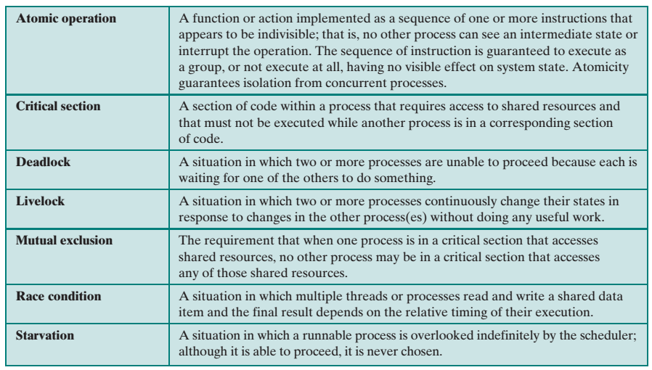
Terms related to Concurrency (1)

Slide 8
Problems in Concurrency
Sharing global resources
Management of allocation of resources
Programming errors difficult to locate

Slide 9
Example of Concurrency Problem
void echo()
{
chin = getchar();
chout = chin;
putchar(chout);
}
Process P1 Process P2
. .
chin = getchar(); .
. chin = getchar();
chout = chin; chout = chin;
putchar(chout); .
. putchar(chout);
. .

Slide 10
O/S Concerns
Keep track of active processes
Allocate and deallocate resources
Processor time
Memory
Files
I/O devices
Protect data and resources
Result of process must be independent of the speed of execution of other concurrent processes

Slide 11
Competition among Processes for Resources
Mutual Exclusion
Critical sections
Only one program at a time is allowed in its critical section
Example only one process at a time is allowed to send command to the printer
Deadlock
Starvation

Slide 12
Cooperation among Processes
By Sharing
Writing must be mutually exclusive
Critical sections are used to provide data integrity
By Communication
Messages are passes
Mutual exclusion is not a control requirement
Possible to have deadlock
Each process waiting for a message from the other process
Possible to have starvation
Two processes sending message to each other while another process waits for a message

Slide 13
Mutual Exclusion
Only one process at a time is allowed in the critical section for a resource
A process that halts in its non-critical section must do so without interfering with other processes
No deadlock or starvation
A process must not be delayed access to a critical section when there is no other process using it
No assumptions are made about relative process speeds or number of processes
A process remains inside its critical section for a finite time only

Slide 14
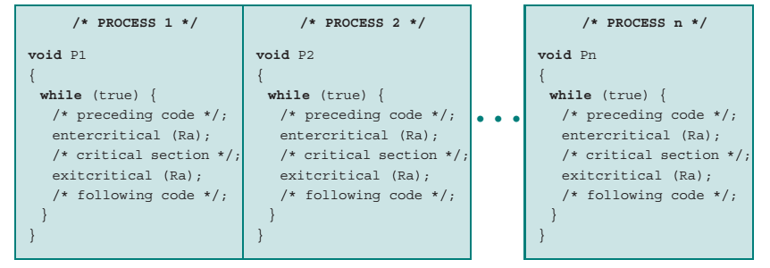
Illustration of Mutual Exclusion

Slide 15
Mutual Exclusion with Hardware Support
Processes attempting to enter their critical section go into a busy waiting mode.
Busy waiting or spin waiting: a technique in which a process can do nothing until it gets permission to enter its critical section but continues to execute an instruction or set of instructions that tests the appropriate variable to gain entrance
Proposals for achieving mutual exclusion
Disabling interrupts
Compare and swap instruction
Exchange Instruction

Slide 16
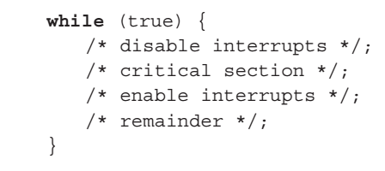
Mutual Exclusion with Hardware Support
Interrupt Disabling
A process runs until it invokes an operating-system service or until it is interrupted
Disabling interrupts guarantees mutual exclusion
Processor is limited in its ability to interleave programs
Multiprocessing
disabling interrupts on one processor will not guarantee mutual exclusion

Slide 17
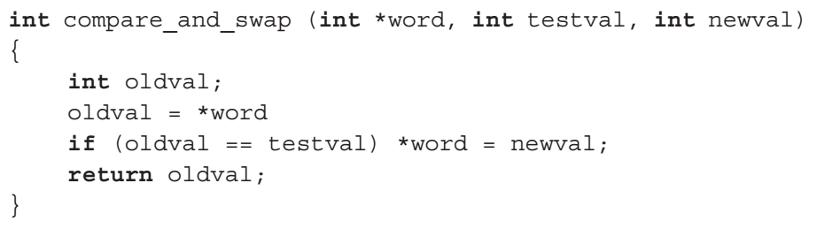
Mutual Exclusion with Hardware Support
Compare and Swap Instruction (compare & exchange)
A Compare is made between a memory value and a test value
if the values are the same, a swap occurs
The function is run atomically

Slide 18
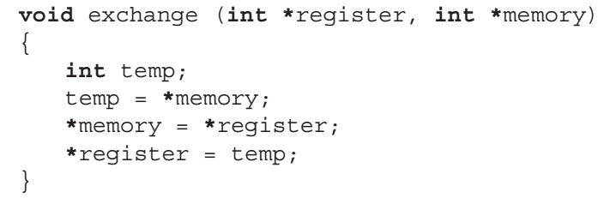
Mutual Exclusion with Hardware Support
Exchange Instruction

Slide 19
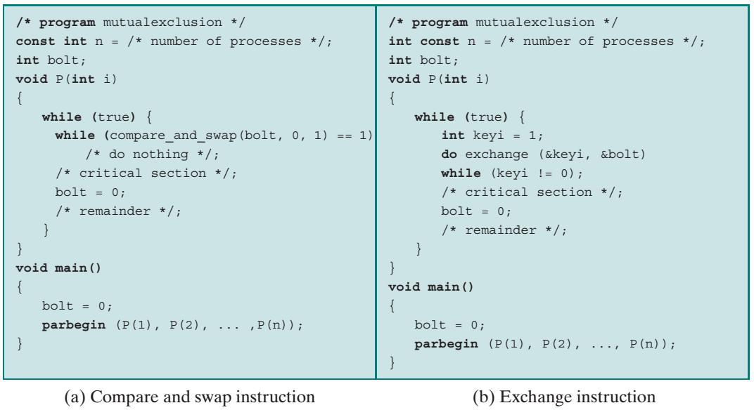
Mutual Exclusion with Hardware Support

Slide 20
Semaphores
Special variable called a semaphore is used for signaling
If a process is waiting for a signal, it is suspended until that signal is sent
Wait and signal operations cannot be interrupted
Queue is used to hold processes waiting on the semaphore
Semaphore is a variable that has an integer value
May be initialized to a nonnegative number
Wait operation decrements the semaphore value
Signal operation increments semaphore value

Slide 21
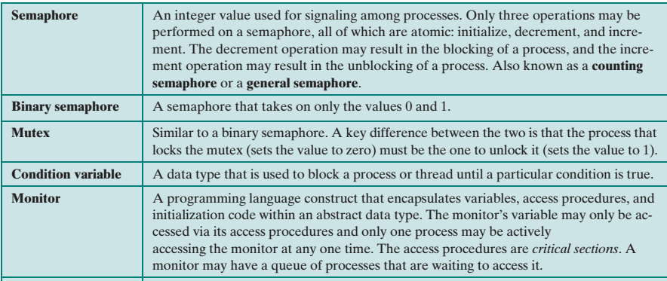
Common concurrency mechanism

Slide 22
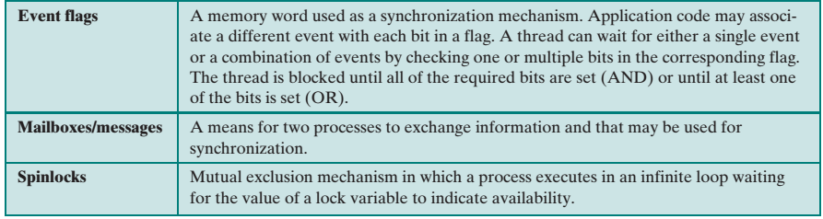
Common concurrency mechanism

Slide 23
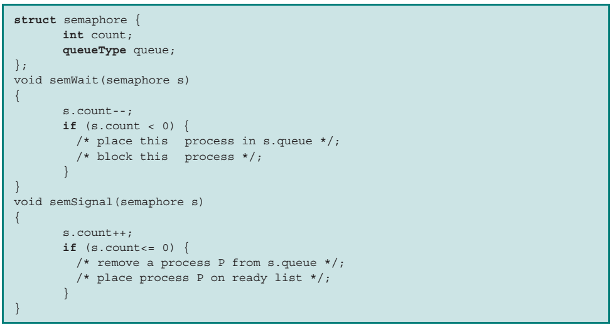
Semaphore primitives

Slide 24
Strong vs Weak Semaphore
Strong Semaphore: The process that has been blocked the longest is released from the queue first
Weak Semaphore: A semaphore that does not specify the order in which processes are removed from the queue.

Slide 25
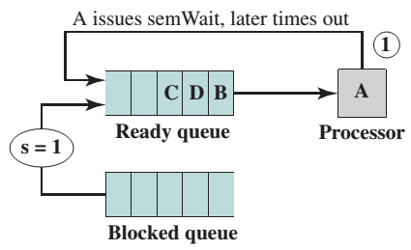
Example: Strong Semaphore
Suppose process A, B and C depends on the result of process D
Initially A is running, B,C and D in ready state, semaphore count is 1 (meaning one od D result is available)

Slide 26
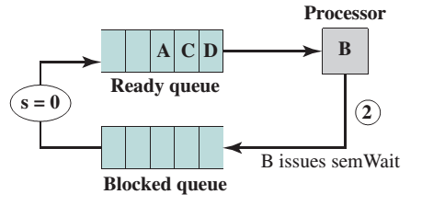
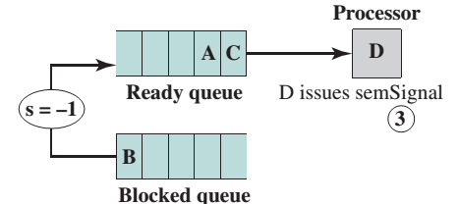
Example: Strong Semaphore
Then B runs (2), eventually issues a semWait instruction, and is blocked, allowing D to run

Slide 27
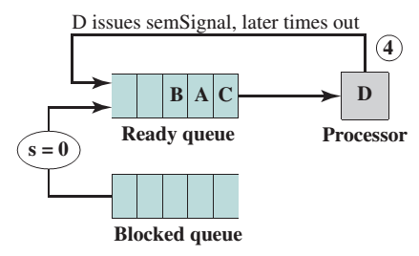
Example: Strong Semaphore
When D completes a new result, it issues a semSignal instruction, which allows B to move to the ready queue

Slide 28
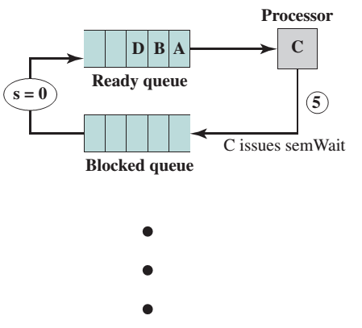
Example: Strong Semaphore
D rejoins the ready queue and C begins to run but is blocked when it issues a semWait instruction

Slide 29
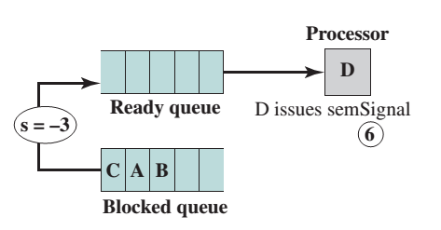
Example: Strong Semaphore
Similarly, A and B run and are blocked on the semaphore, allowing D to resume execution

Slide 30
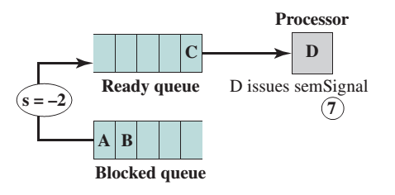
Example: Strong Semaphore
When D has a result, it issues a semSignal, which transfers C to the ready queue

Slide 31
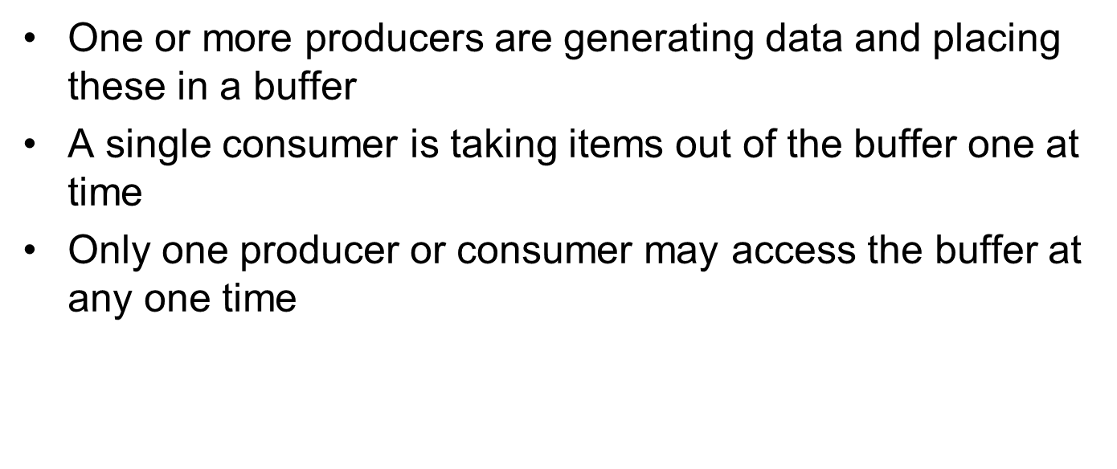
Producer-Consumer’s Problem (1)

Slide 32
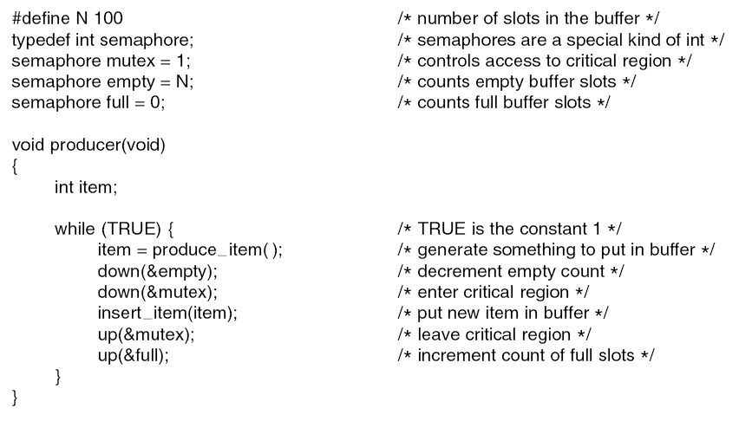
Producer-Consumer’s Problem using Semaphore(1)

Slide 33
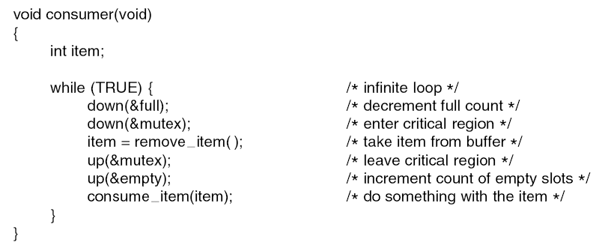
Producer-Consumer’s Problem using Semaphore(2)

Slide 34
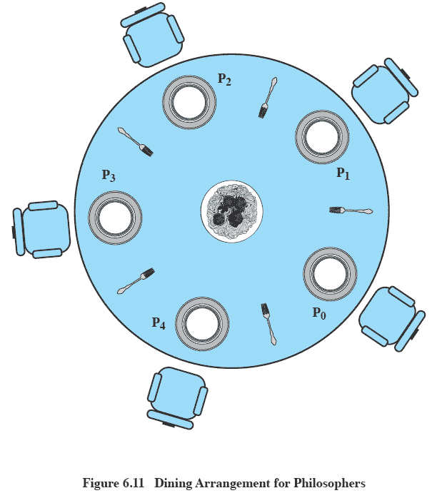
Dining Philosopher’s Problem
Source: Slberschatz, Galvin, Gagne, Operatig System Concepts.

Slide 35
Dining Philosopher’s Problem
The system may deadlock: if all 5 philosophers take up their left chopstick simultaneously, the system will halt (unless one of them puts one back)
A philosopher may starve if her neighbors have alternating eating patterns

Slide 36
Other classical concurrency problem
Sleeping Barber Problem
Reader’s Writer’s Problem

Slide 37
References
Stallings, W. (2014). Operating Systems: Internals and Design Principles. 8^{th.} ISBN: 978-0-13-380591-8
Abraham Silberschatz, Peter B. Galvin, Greg Gagne (2010). Operating System Concepts 8th ed. With Java
ISBN: 978-0-470-50949-4
A. Tanenbaum(2007), Modern Operating System, 3rd
ISBN: 978-0136006633

